Slide 1
Blockchain and the movement of value in Africa
CAI Jiaxuan, LUO Yiling, SUN Yanjin
WANG Zichen, WEI Shan, ZHU Zihan
09/03/2023

Slide 2
Overview
01
03
Introduction
Discussion on Blockchain Technology
02
04
Three Cases
Possible Solutions and Conclusion

Slide 3
Meaning of core features
Smart Contract
Oracle
terms and conditions are entered into by two or more parties (similarity)
the implementation of the contract is done digitally without the need for a third party to track performance or execution (Difference)
an agent that finds and verifies real-world occurrences and submits this information to a specific blockchain to be used by smart contracts
Smart contracts (implementer) gather and verify the data through oracles (mechanism/software).

Slide 4
Advantages
Transparency
Decentralization
Immutability
…
To ameliorate these issues:
A lack of transparency
Shortage of trust

Slide 5
The Background: Issues in Africa
Many countries in Africa are large recipients of foreign aid. However, there are various filters before foreign aid reaches the end user. People cannot track and audit the use of foreign aid.
Not transparent! Transactions are not immutable!
The number of immigrants from Africa is approximately 20 to 30 million adults, who send around $40 billion USD annually back using physical cash.
The transfer of physical cash is not transparent!
It is challenged to start a business in Africa due to long loan application processing time and high cost.
The bank‘s distrust of the repayment ability of borrowers.
Notes:
Let me introduce this type of issues in Africa

Slide 6
Case 1: Foreign Aid in Africa

Slide 7
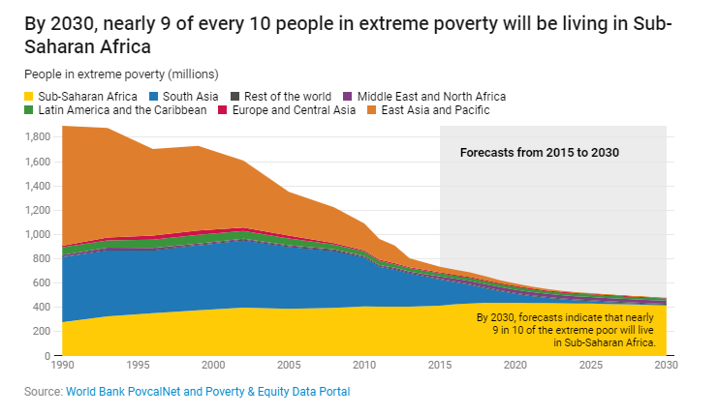
Current status of Foreign Aid in Africa
Brief review
Challenges for foreign aid in Africa
Avoid corruption
Minimize cost

Slide 8
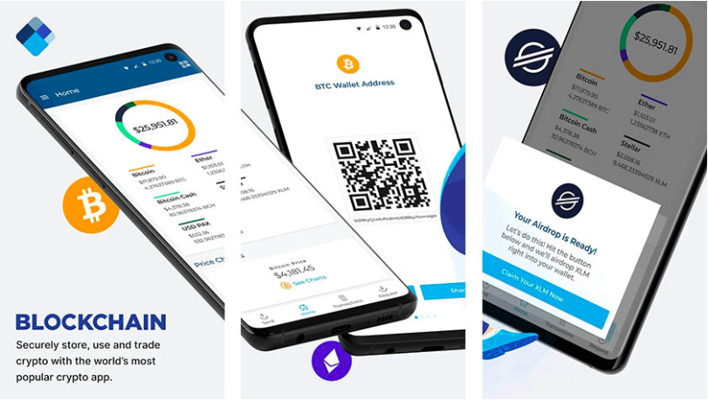
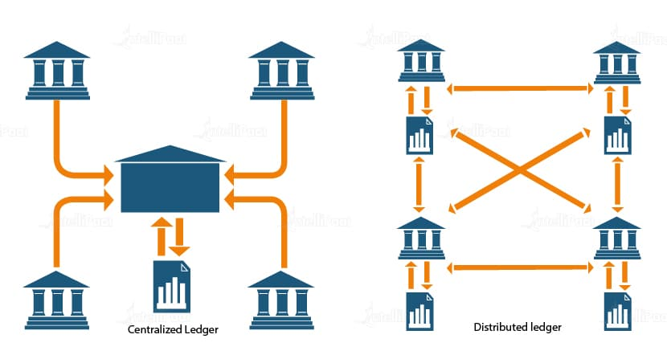
Foreign Aid in Africa: How to solve corruption issue?
Digital wallet
Using ledger to record every transaction so that aid can be tracked and monitored.
Reduce the costs associated with aid distribution
Eliminates the need for intermediaries and streamlines the distribution process

Slide 9
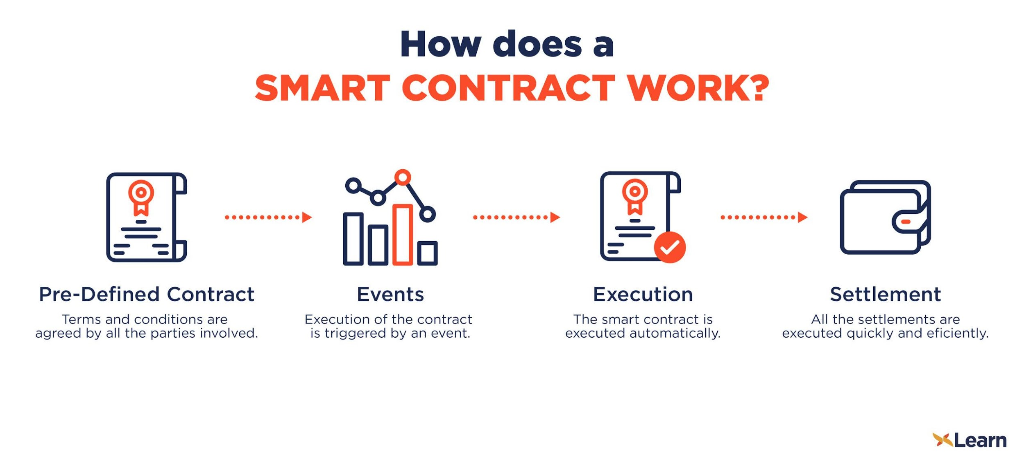
Foreign Aid in Africa: How to solve inefficiency issue?
Smart contracts
Using smart contracts for releasing the funds automatically once specific milestones or requirements are achieved
Avoid risk of manipulation by third parties
Improve accuracy
Increase speed of transmission

Slide 10
Potential risk
Lack the technical expertise and infrastructure to support block chain technology& Poverty .
Governments and aid organizations may resist implementing blockchain technology because they may be the vested interests.
Cost of implementing and maintaining a blockchain-based system

Slide 11
Solving suggestion
Popularize blockchain concept
Negotiate with the government and stakeholder
Volunteers

Slide 12
Case 2: Remittances for individual

Slide 13
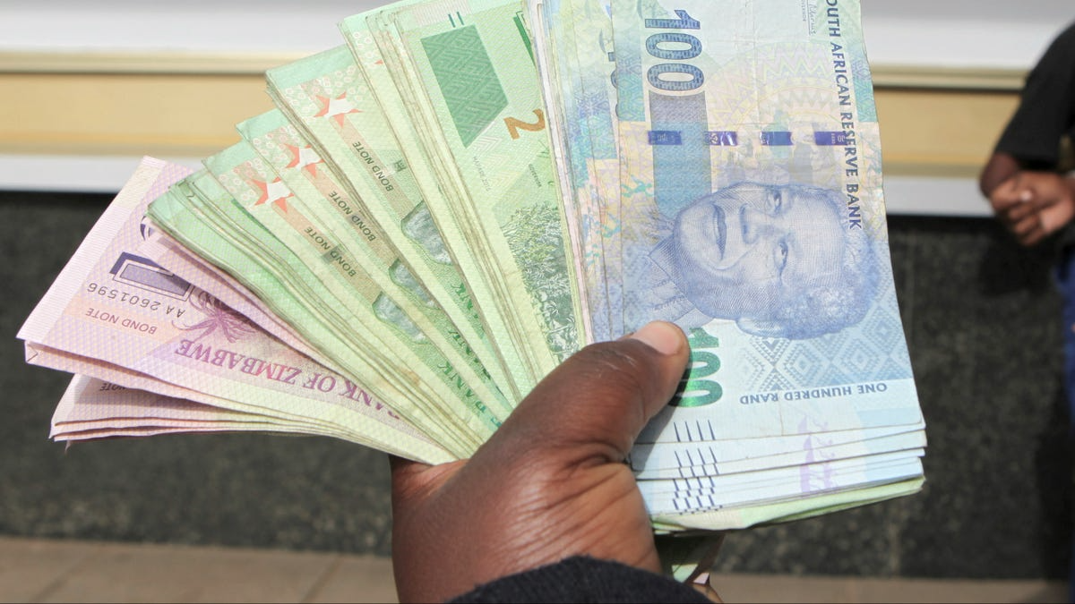
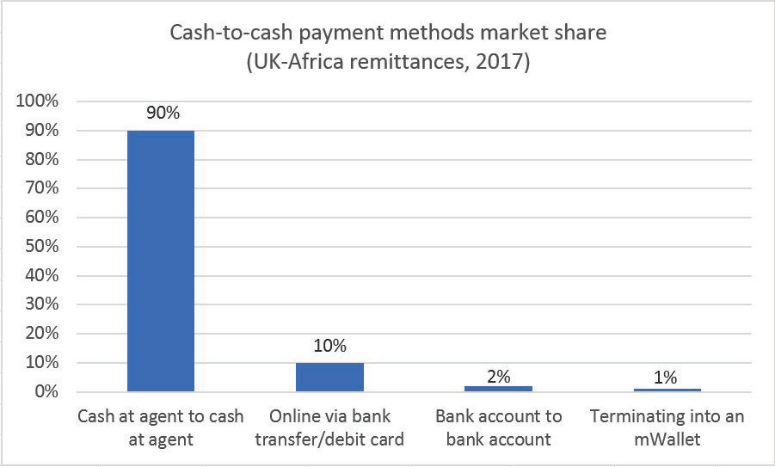
Data migration process infographics
Large amount of remittances sent to Africa by African immigrants
Mainly cash transfer due to lack of digital literacy and trust in online financial services, and rural population's access to pay-out locations

Slide 14
Difficulties
High transfer cost
Low efficiency
charged by multiple tiers of banks and money transfer operators
The paper-based process causes long transaction time

Slide 15

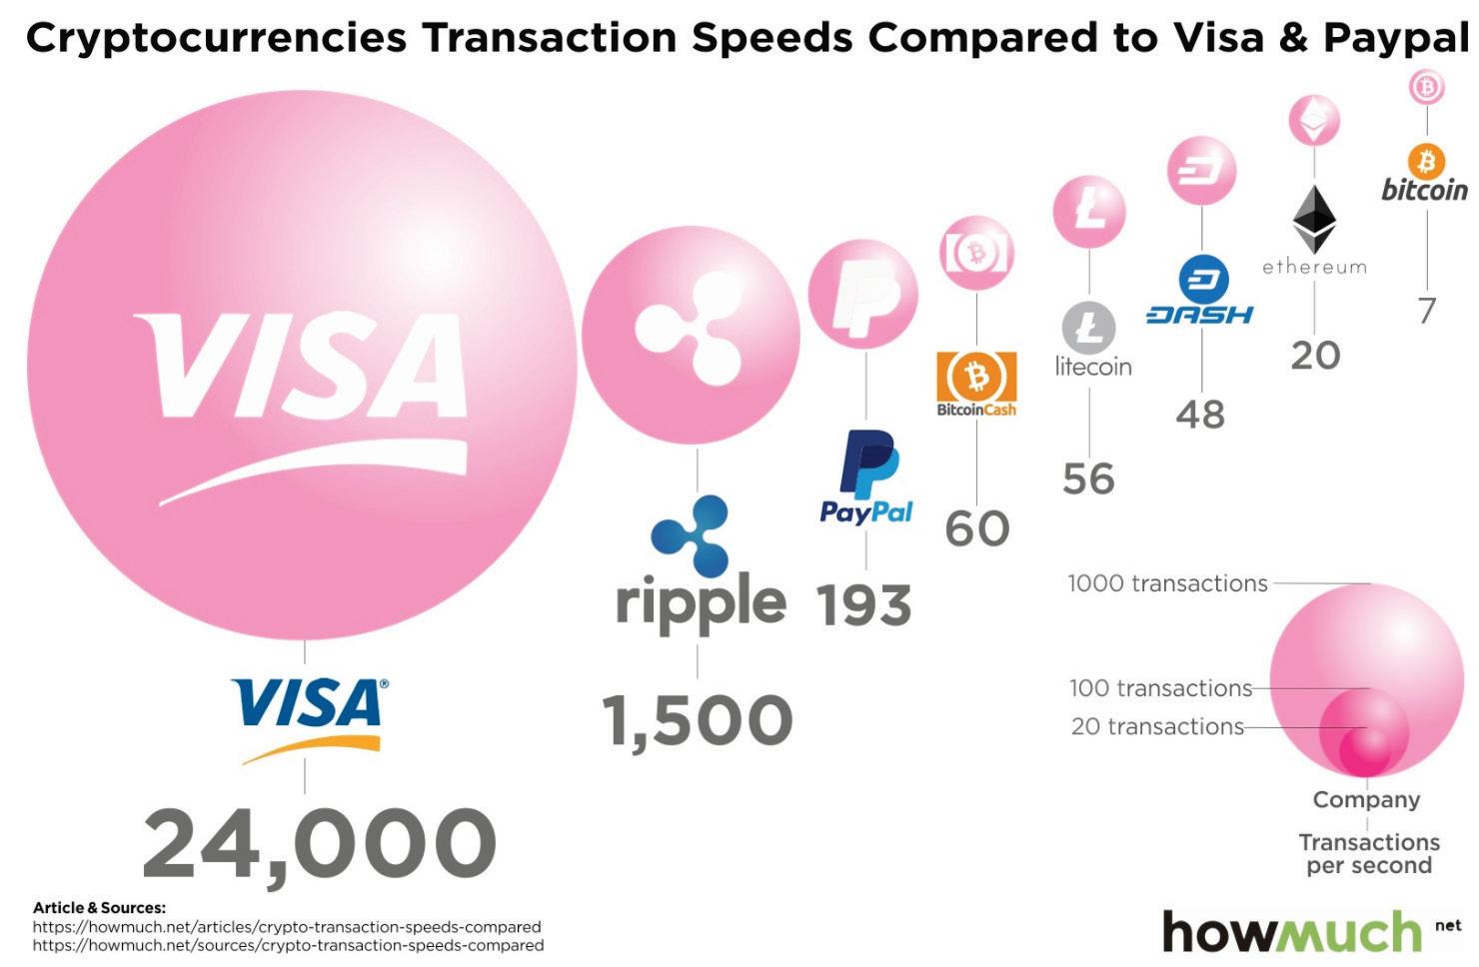
Solution
Application “Bitpesa”
Further research
Cryptocurrency
allow users to send money back home with lowest fees and fastest speed
allow their customers to purchase and sell Bitcoin, creating a common payment channel with negligible transaction fees
Create “plumbing” of the financial system to achieve more convenient payment transaction, e.g.Interledger Protocol
Blockchain technology

Slide 16
Potential risk
Lack of digital knowledge
could be hard to be accepted by recipients who have low trust and few experience in online transactions
Lack of security
Greater responsibility for users; fewer protectors during transaction

Slide 17
Suggestion
Education
To inform recipients of the benefits of digital remittance applications
Security
improve the security during traction; blockchain technology is strong in transparency to avoid bad actors.

Slide 18
Case 3: SME Financing in Africa

Slide 19
SMEs are important
SMEs play a key role in both job creation and the development of the economy in Kenya
Job creation
Development of the economy
In 2014, 80% of job created were largely driven by the SME sector
SME contributes to Kenya’s GDP at about 45%

Slide 20
Difficulty for SMEs Seeking Financial Services
Lack of trust
Lack of data
Lack of trust in the ability of SMEs to evade
Enterprise operating data, credit data
Slow risk assessment by banks
High Financing Threshold
Many SMEs cannot meet the threshold of financing
In order to reduce risks, banks have a sound but lengthy risk assessment process

Slide 21
Blockchain as A Solution
Smart contract
Credit score
Land Title Registration
Industrial financial chain

Slide 22
Potential Risk
Infrastructure support
The application of blockchain depends on the Internet and terminal equipments
Regulatory issues
Such as the legal recognition of smart contracts

Slide 23
Suggestion
The government needs to support blockchain construction both in legal and infrastructure
IoT, Blockchain and Financial Business Process Integration
Accounts Receivable Financing

Slide 24
Discussion on Blockchain Technology

Slide 25
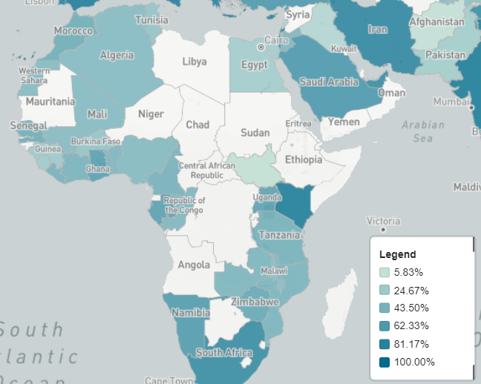
Why Blockchain?
Advantage of Blockchain
Transparent & trustless
Why is Blockchain Relevant?
A database structure is needed in financial activities.
Stakeholders need to collaborate digitally.
Some stakeholders are not trusted.

Slide 26
Issues Blockchain Technology Need to Overcome (PESTEL)
Local government may have concerns & lack incentives
Political
Creating risks for financial stability (borderless transactions on the blockchain)
Squeeze profit margin of the government
Economical
Social
Technological
Environmental
Legal

Slide 27
Issues Blockchain Technology Need to Overcome (PESTEL)
Positive impact but lack incentives
Political
Strong positive impact on the economy
But lack incentives to build
Economical
Social
Technological
Environmental
Legal

Slide 28
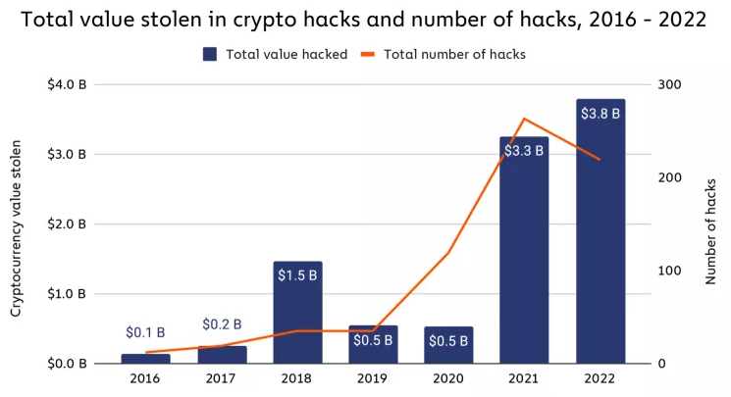
Issues Blockchain Technology Need to Overcome (PESTEL)
Convenience & safety for local residents
Political
Inconvenient procedure to input the address of receiver and pending verification.
Private key stolen / hacked.
Economical
Social
Technological
Environmental
Legal

Slide 29
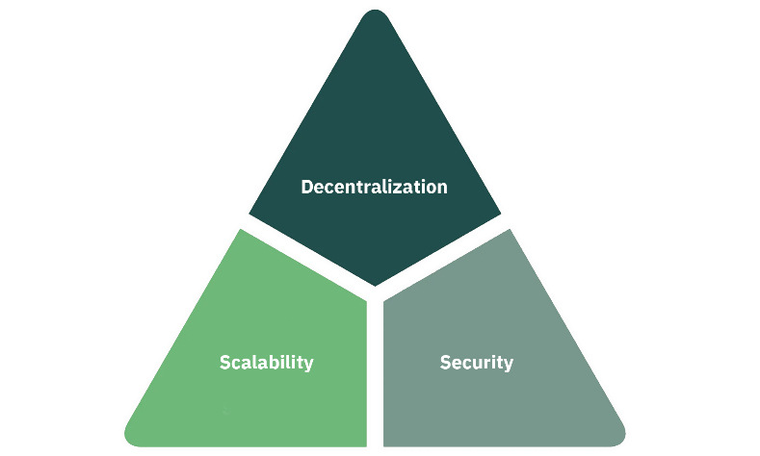
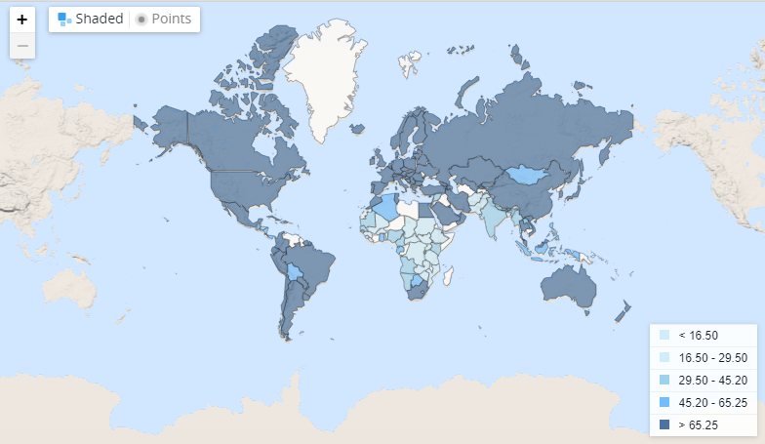
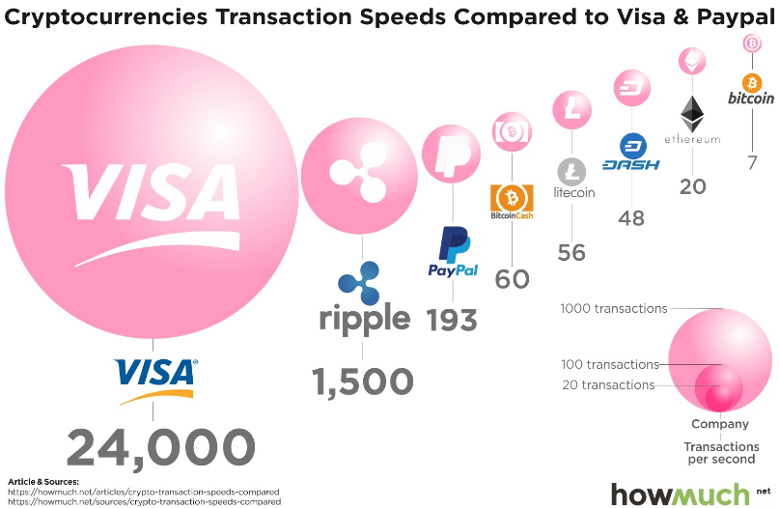
Issues Blockchain Technology Need to Overcome (PESTEL)
Infrastructure & trilemma
Political
Economical
Social
Technological
Environmental
Legal
Low internet accessible rate

Slide 30
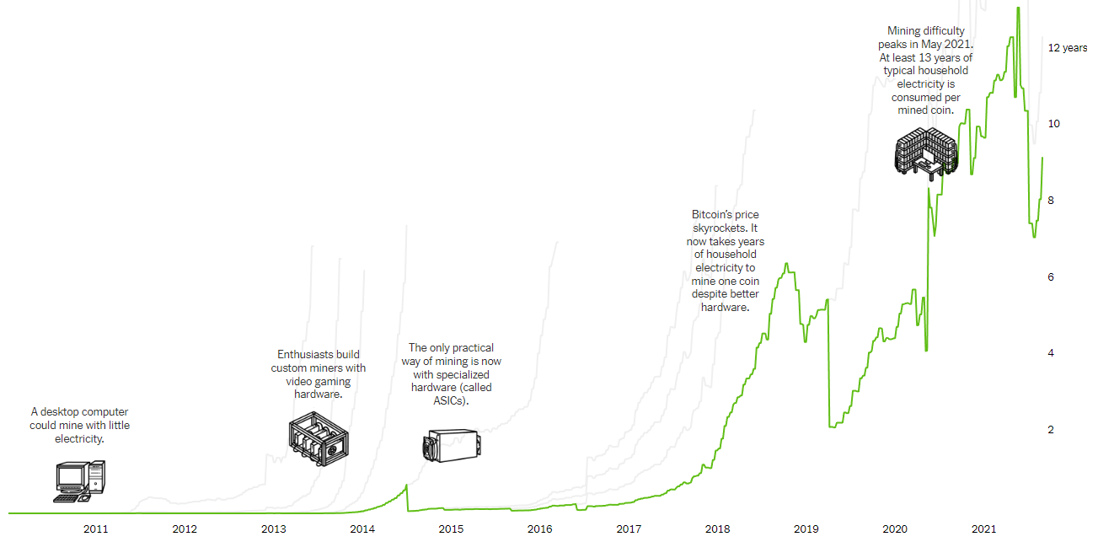
Issues Blockchain Technology Need to Overcome (PESTEL)
Mining in POW system is energy intensive
Political
Economical
Social
Technological
Environmental
Legal
Average years of household-equivalent electricity to mine one Bitcoin

Slide 31
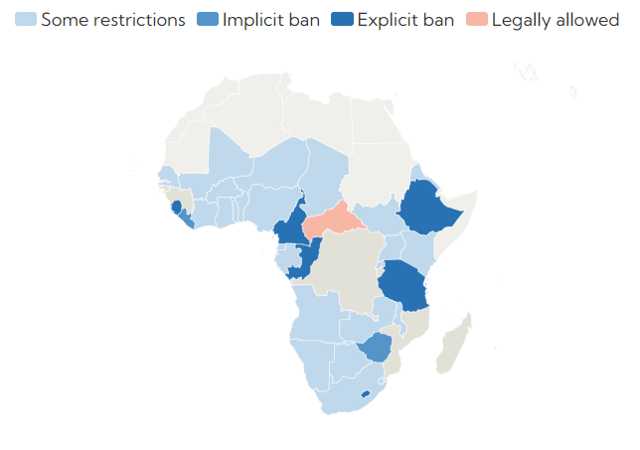
Issues Blockchain Technology Need to Overcome (PESTEL)
About 20% of African countries have banned crypto assets
Political
Economical
Social
Technological
Environmental
Legal
Crypto clampdown

Slide 32
Possible Solutions and Conclusion

Slide 33
Incentive Programs
PoW in Bitcoin
Without Incentive
Less Computation Power
Security Reduction
Usage Limitation
PoS in Ethereum
DPoS in BitShares

Slide 34
Hybrid Blockchain
A Hybrid Blockchain is useful if there is a need for a group of entities to control the functionality and consensus is determined by a specific group of entities.
Political
Technological
Allow organizations to share information; co-sign
Greater scalability
Economical
Environmental
Managed by a consortium of relevant players
Get rid of incentive programs and save energy

Slide 35
Social
Use custodial wallets
Technological
Solve the problem at hand
Private key is entrusted to a third party
Solve the problem of private key theft or loss
Direct aid to infrastructure development for developing countries
BitGive: focus on humanitarian work in the developing world

Slide 36
Thank you for listening

